Slide 2
PowerBI y Cortana Analytics de 0 a 100
Rubén Pertusa López
BI BigData Architect @ Financial Risk Management BIS
Data Platform MVP
rpertusalopez@gmail.com @rpertusa

Slide 3

Rubén Pertusa López
Microsoft Data Platform MVP
BI & Big Data Architect @ Financial Risk Mgmt BIS
Future Data Mining PhD
www.sqlpass.es , SQLSaturday Madrid/Barcelona founder
Speaker: PASS BA Chicago, SQLSaturdays, Sharepoint Conference…
rpertusalopez@gmail.com
Twitter: @rpertusa
Web: www.rpertusa.com

Slide 4
Objetivo
1000 ideas

Slide 5
Agenda
De 0 a 100 en Power BI
Un paso más allá
PowerBI en Cortana Analytics

Slide 6
De 0 a 100

Slide 7
“Without data you’re just another person with an opinion.” W.Edwards Deming

Slide 8


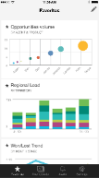
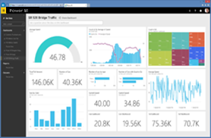
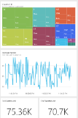
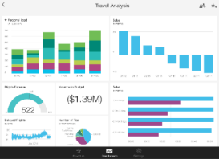
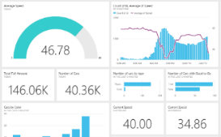
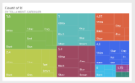
El ecosistema PowerBI
Power BI Desktop
+
Power BI Service www.PowerBI.com
(Free Client 32/64 bits)
(Free & Pro)
Prepare
Explore
Report
Share
Content packs
Natural language query
Live dashboards
Sharing & collaboration
Visualizations
0101
Power BI REST APIs
01011
Reports
01001
10101
Power BI Apps
Datasets
Data refresh

Slide 9

Herramienta para usuario de negocio
Sin potencia

Slide 10
DEMO Potencia con control.

Slide 11
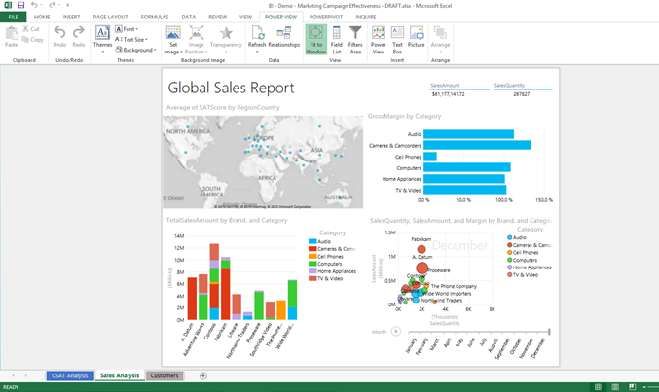
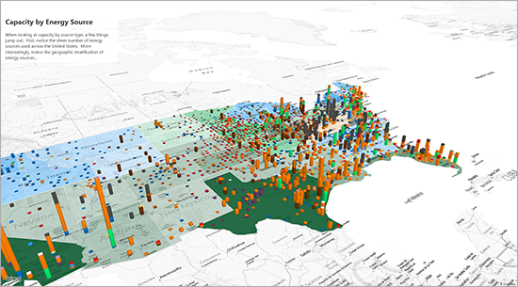
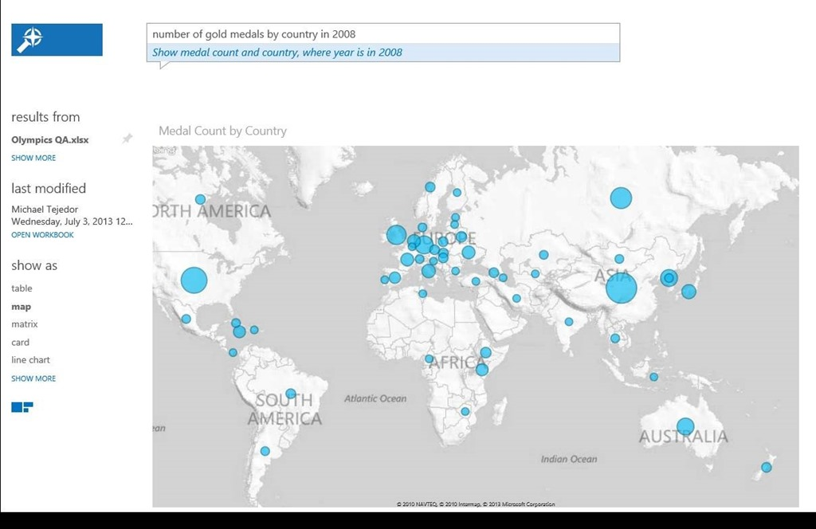
¿Es PowerBI un producto V1?
SQL
Server
2008R2
SQL Server 2012
Excel
2013
Office
365
2015
Power Pivot add-in for Excel 2010
Power Pivot v2 for Excel 2010
Power Pivot & Power View native
Power BI Sites
(new PowerBI.com)
Power BI v2
Power View on SSRS 2012
Power Query add-in for Excel 2013
Mobile apps
Power Pivot
& Power View
& Power Query
native on Excel 2016
Power Map add-in for Excel 2013

Slide 12
Pequeña chuleta (PowerBI)
Modelo de datos
Power Pivot / Analysis Services Tabular
Lenguaje DAX
Transformación de datos
Power Query
Lenguaje M
Power BI de 0 a 100

Slide 13
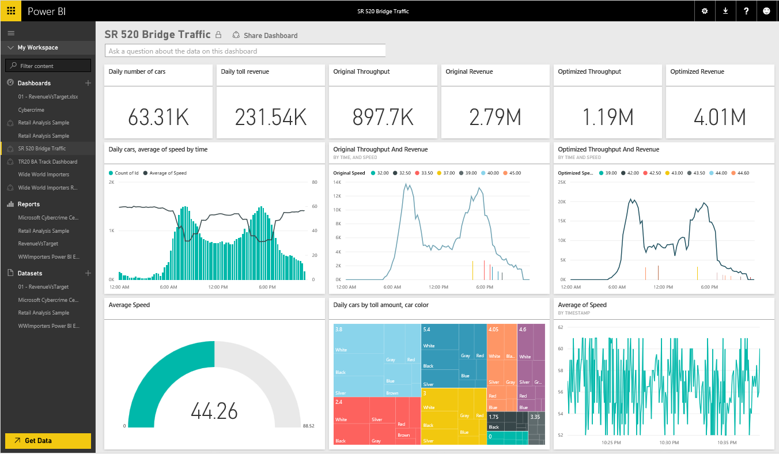


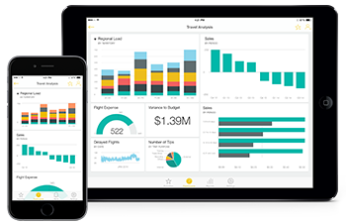

Trabajando con PowerBI
Herramientas de análisis
Microsoft Cloud
Web browser
Excel
Power BI Service (PowerBI.com)
Power BI Desktop
Live / Import
Live / Import
Orígenes de datos
On-prem
Orígenes de datos
Cloud
Otros
Mobile apps
Analysis Services
Azure Data Services
(HDInsight,Spark,…)
Data streams
IoT
PowerBI API REST
SQL Server, Access
SQL Azure & DW
Files
(CSV, Excel, Json, txt)
Dynamics, SaaS App
Web
+ 60 Orígenes de datos

Slide 14
DEMO Sacando todo el jugo a las APIs

Slide 15
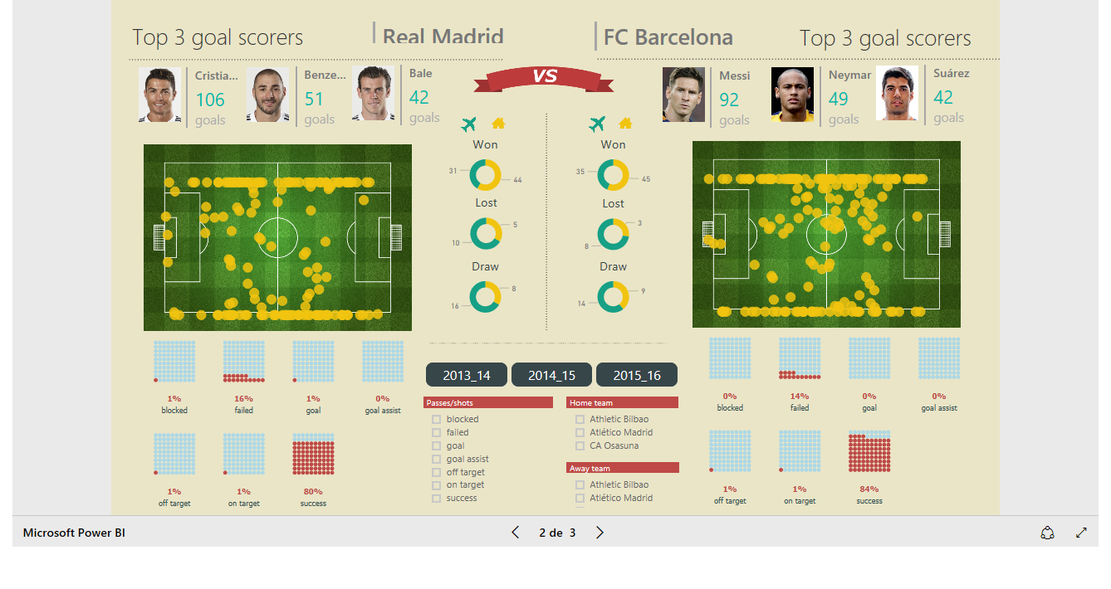
https://youtu.be/Yl9VEY-zkYk

Slide 16
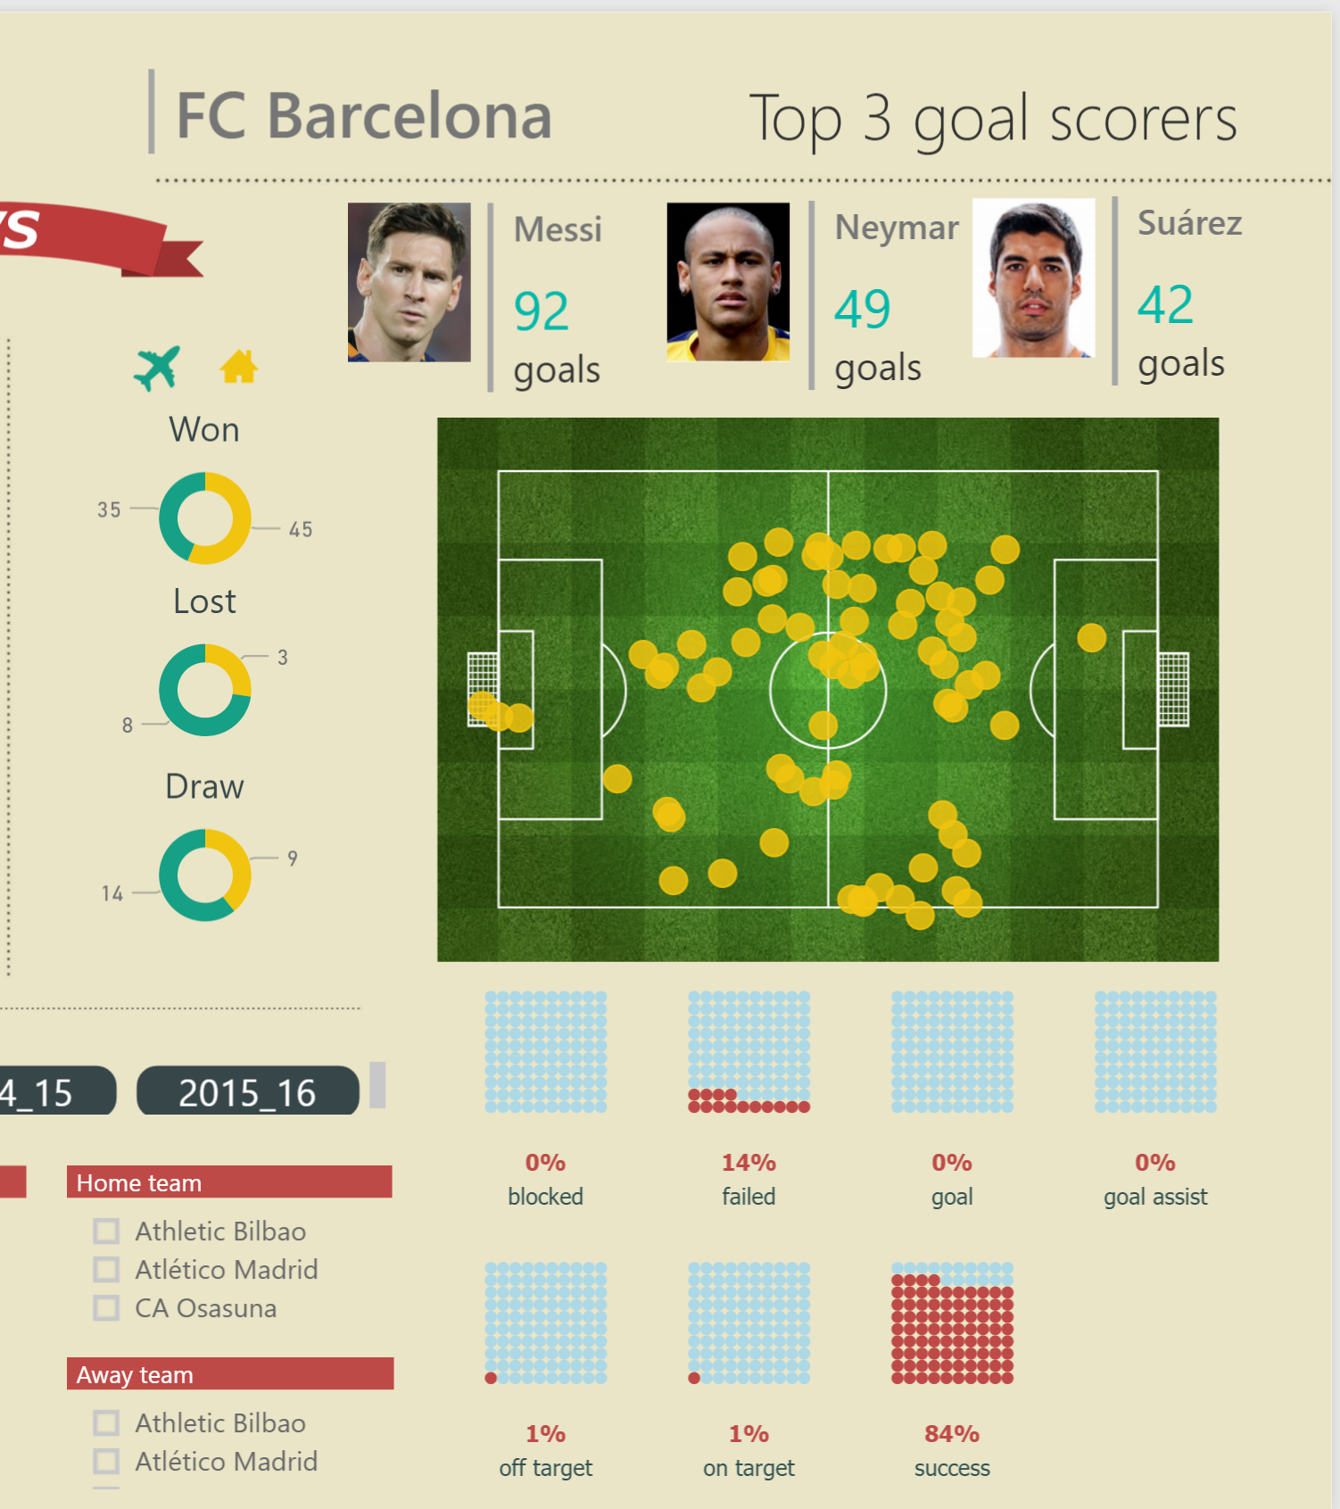
Think different.

Slide 17





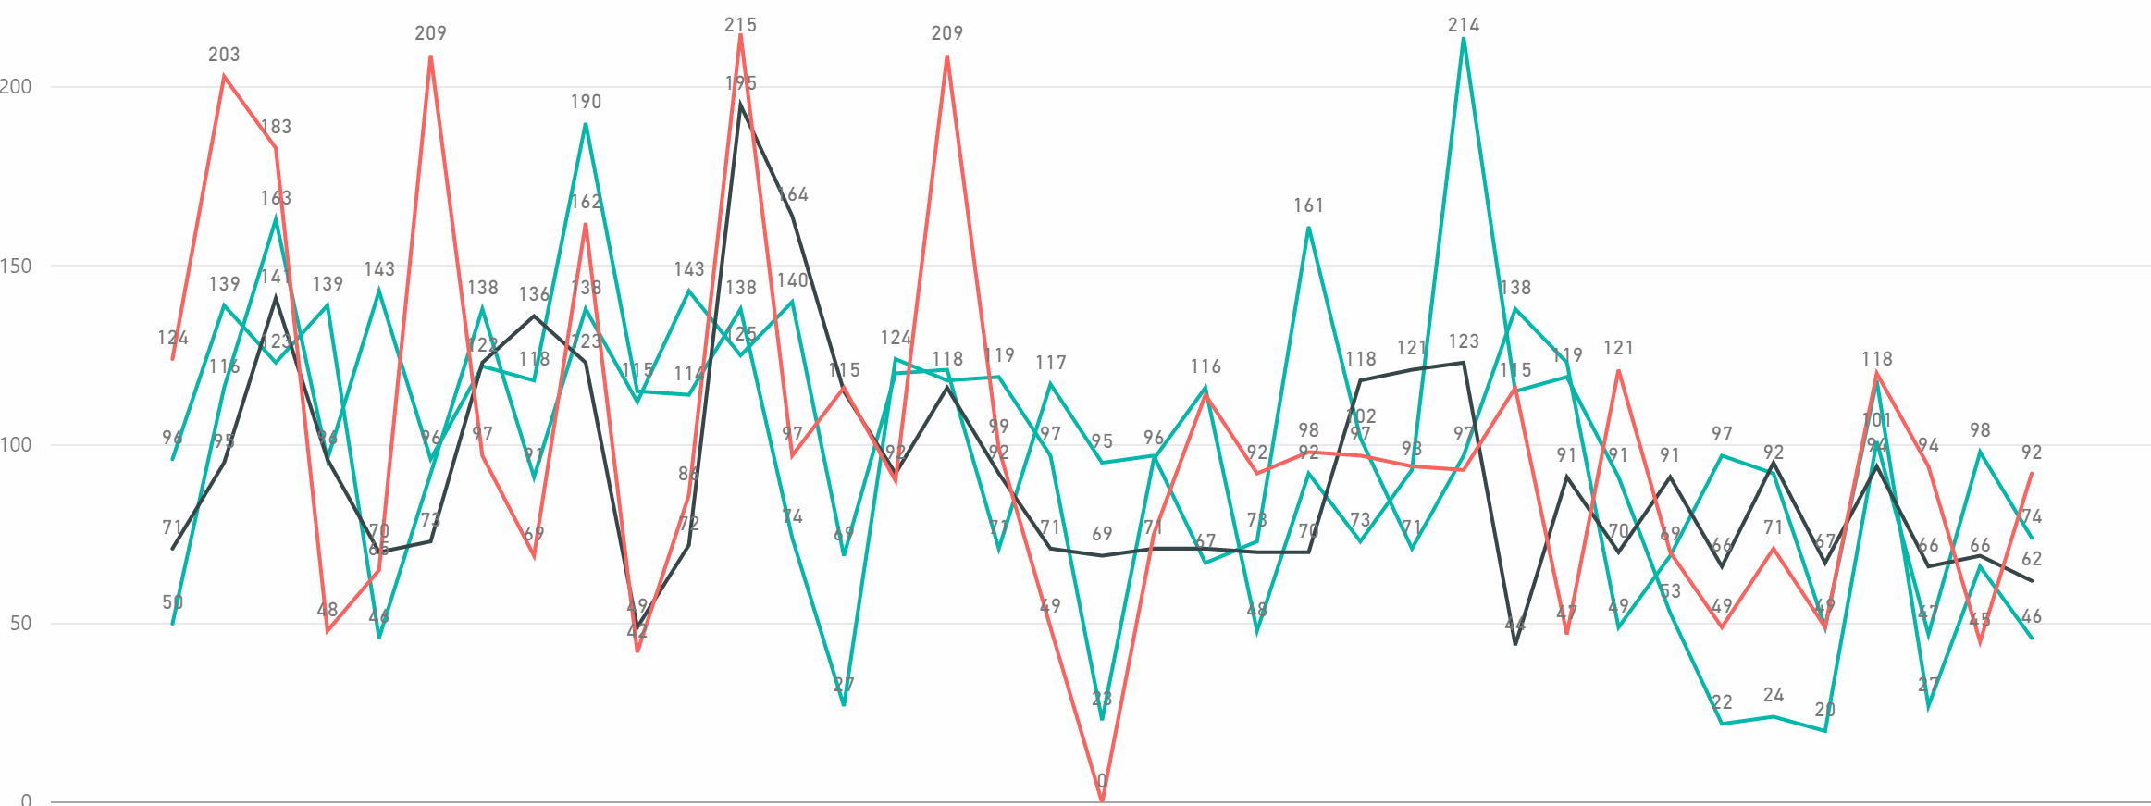
Think different.

Slide 18
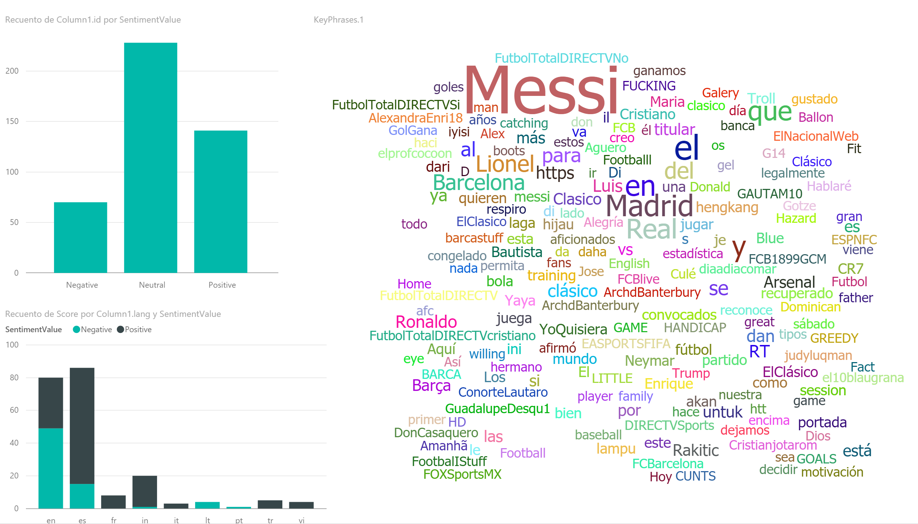
Think different.

Slide 19
Un paso más allá

Slide 20
Sin limites
Visualizaciones
Oficiales, R Visuals, visuals.powerbi.com, Custom
Integracion
Exportar a CSV, Importar desde Excel, Pinear Excel, SSRS,
Lenguajes
M, DAX, R, Transformación en origen.

Slide 21

DEMO Mejorando

Slide 22
Beneficios del Personal branding
Conexión con tu audiencia objetivo
Credibilidad
Exposición pública
Diferenciarse de la competencia
Notes:
Personal branding success requires communicating your message to the right people — not necessarily to the entire world. And it requires communicating in a way that creates emotional connections with your target audience. You simply cannot build a solid brand without building relationships, which are based on emotional connections.
Your actions, which align with your brand, validate that you can be trusted and show that you are credible.
You need to specialize and have an area of expertise. When asked what you do best, your answer can’t be “everything.” No one knows what that means. To develop a specialty, the best place to start is with what you know.
What can you do that few others know how to do? What segment of the population do you understand better than most people in your field do?
You have a unique combination of work experience, life experience, and personal characteristics that create the foundation for determining your niche. To be known in a certain niche, you are wise to choose an area of expertise or market segment that you know well and that you enjoy.

Slide 23
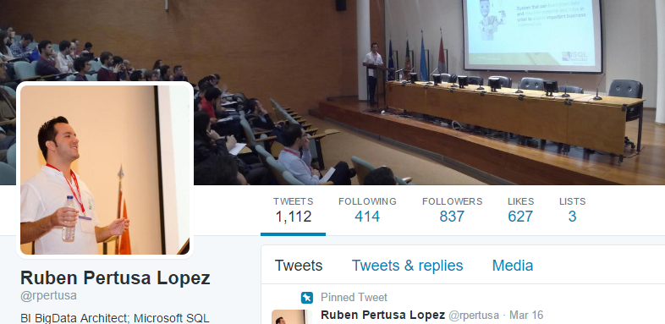
Beneficios del Personal branding

Slide 24
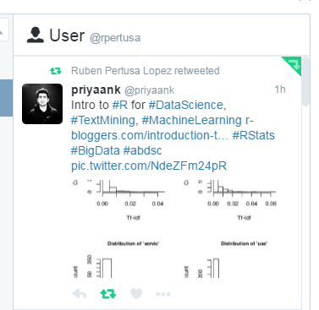
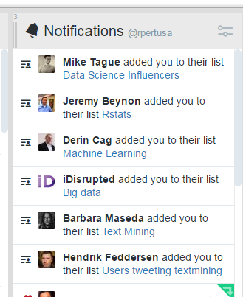
¿Hay alguien ahí?

Slide 25
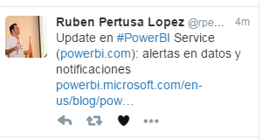

¿Hay alguien ahí?

Slide 26
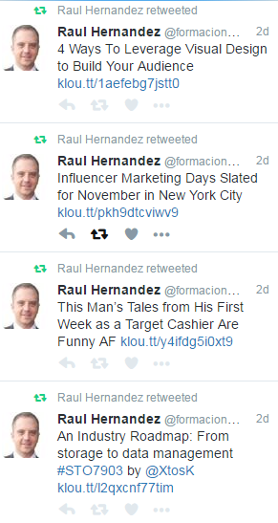
¿Hay alguien ahí?

Slide 27
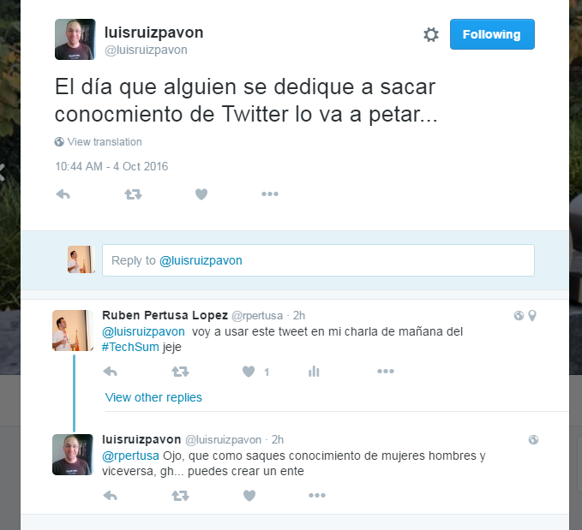

Slide 28
DEMO Mejorando

Slide 29
Cortana Analytics Suite

Slide 30







PowerBI en Cortana Analytics Suite
Information Management
Big Data Stores
Machine Learning and Analytics
Dashboards and Visualizations
Business apps
Azure
Storage
Power BI
Azure
Machine Learning
Personal Digital Assistant
Azure
Data Factory
Azure
Data Lake
Cortana
People
Custom apps
Azure
HDInsight (Hadoop)
Perceptual Intelligence
Azure
Data Catalog
Face, vision
Azure
SQL Data Warehouse
Speech, text
Azure
Stream Analytics
Azure
Event Hub
Business Scenarios
Sensors and devices
Recommendations,
customer churn,
forecasting, etc.
Automated Systems
DATA
INTELLIGENCE
ACTION

Slide 31


Real-Time en PowerBI
Opción 1. PowerBI API Rest (push data)
Opción 2. Lambda architecture
Events
Azure Data Services
Storage
SQL DW
SQL Azure
Batch Layer
Serving Layer
Speed Layer
Stream Analytics
Power BI Service
(PowerBI.com)

Slide 32
DEMO Monitorizando en tiempo real

Slide 33
En resumen
1000 ideas

Slide 34
PREGUNTAS?

Slide 35

Gracias! ☺
Ruben Pertusa Lopez
BI Big Data Architect @ Financial Risk BIS
Data Platform MVP
rpertusalopez@gmail.com
Twitter: @rpertusa
www.rpertusa.com
aka.ms/MTS62

